Slide 1

Pair Trade Strategy
Anuj Singh
Sudhanshu Gupta

Slide 2
What is Pair trade
Pair trading, also known as statistical arbitrage or relative value trading, is an investment strategy that involves taking a long position in one stock while simultaneously taking a short position in another stock that is statistically correlated. The aim of pair trading is to profit from the relative performance between the two securities while neutralizing overall market exposure.

Slide 3
Uses, importance, and Relevance In Financial Markets
Risk Management and Hedging
Exploiting Market Inefficiencies
Enhancing Portfolio Returns
Flexibility and Adaptability
Quantitative and Algorithmic Trading
Risk-Adjusted Returns
Arbitrage Opportunities

Slide 4
Our Strategy- Unsupervised Learning
Step 1: Split the data
Train data follows: 19/03/2018- 31/12/2022
Test Data Follows: 01/01/2023-17/03/2023
Same Sector makes pair
Same Growth over the years
Strategy: Train data should not get biased by covid data.

Slide 5
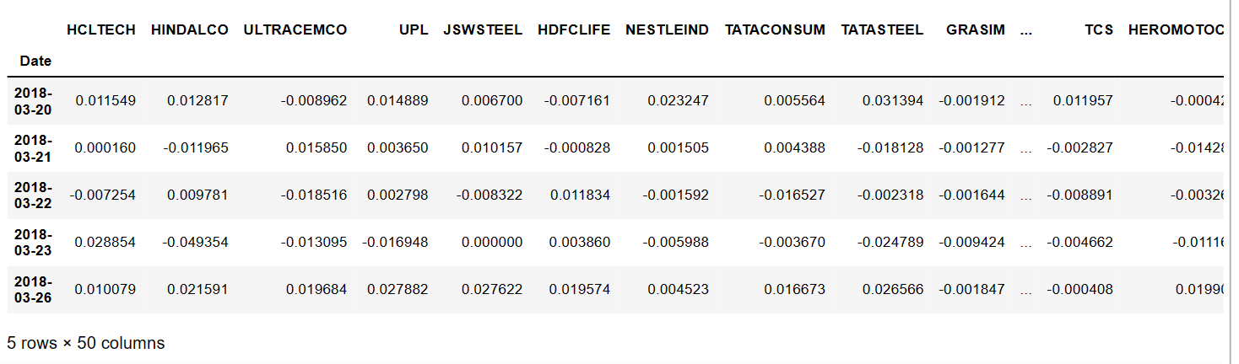
Step 2- Return Series
We created the return series for whole dataset for comprehensive understanding

Slide 6
Step-3 PCA application
When daily returns are found we do reduce PCA functions which scales down and then compute the correlation matrix for price series and then runs the correlation matrix through PCA.
No. of Components taken are basically 4.
Helps in reducing Noise
Better than K-Means

Slide 7
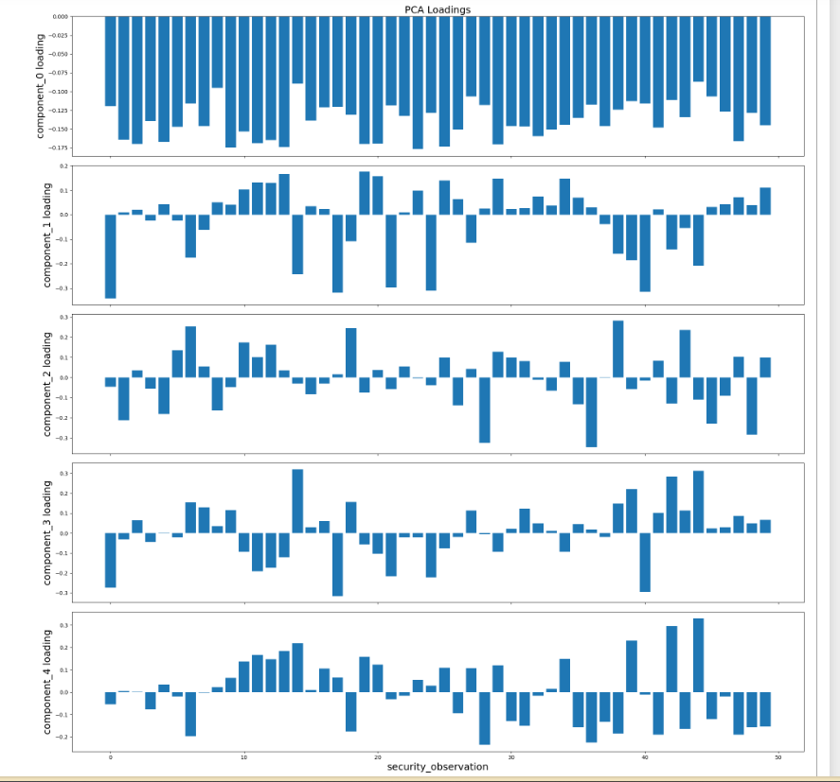

Slide 8
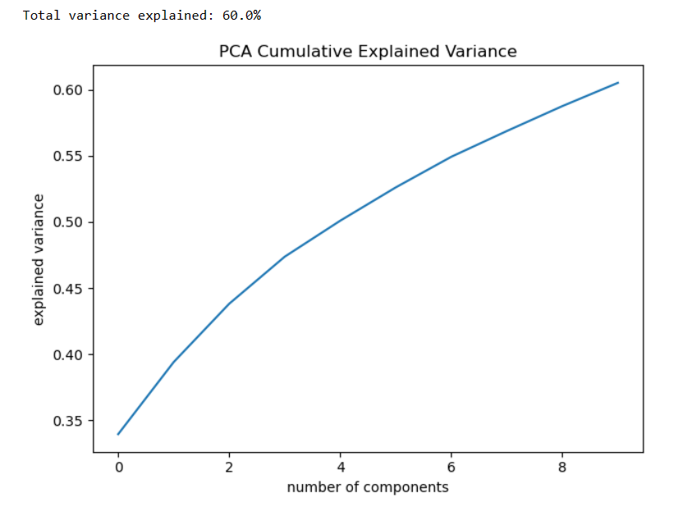
PCA variance within Securities
Dimensionality has been reduced into components and we are able to explain all the variance in data set. 60%.

Slide 9
Step-4 Optics Clustering
We will use optics pair algorithm to capture the pairs. It will ignore the Outliers and capture the relevant data points and fetches the pairs.
We Ignored the K-Means algo because it uses all the data points and that can be misinterpretation as outliers are also captured.

Slide 10
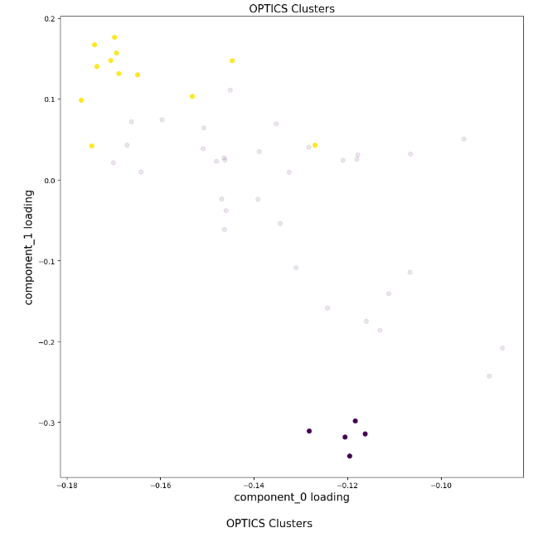
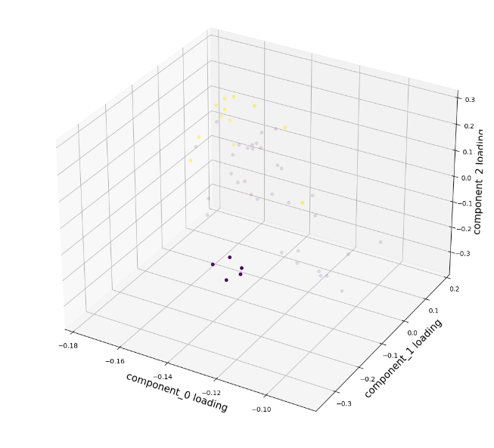
Two Dimensions Component Plot and Finding pairs.
Three Dimensions Component Plot and Finding pairs.

Slide 11
Step-5 Finding Pairs
We tried to find pair as per our criteria.
Following are the criteria-
Statistically significant t-stat from the Engle-Granger test (5% level)
Hurst exponent < 0.5
Half-life between [1, 252]
Spread must cross the mean on average 12x per year
These four criteria indicate positive characteristics for potential pairs of securities. The Engle-Granger tests the pair for cointegration. A Hurst exponent below 0.5 indicates that the pair of prices regresses strongly to the mean. Pairs with extreme half-life values, below 1 or above 252, are excluded from the selected pairs. Extreme half-life values indicate a price series that either reverts too quickly or too slowly to be traded. Finally, the price series must cross the long-term spread mean on average 12 times a year. This enforces one trade on average, per month.

Slide 12
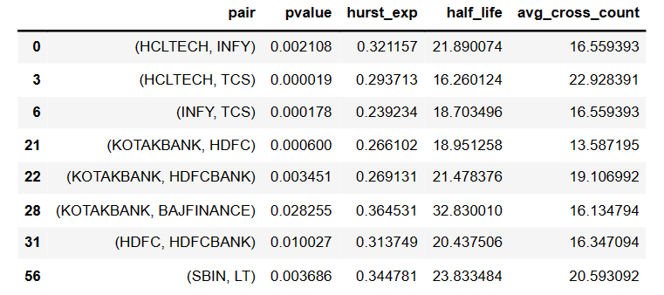
We Found 8 Tradeable Pairs
We drop SBIN, LT as they were not from same Industry

Slide 13
Step- 6 Stationary Tests
Further we planned to initiate the Stationary tests on 7 tradeable stocks we found.
H0: Time series is stationary
H1: Time series is non-stationary
We will perform 3 tests on each stock
1. ADF
2. PP
3. KPSS

Slide 14
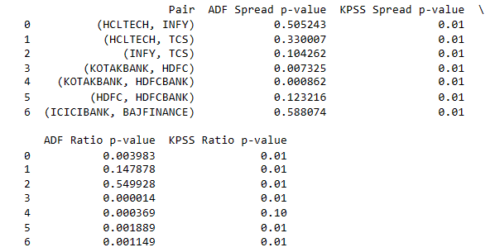
Stationary Test Results
Only [KOTAKBANK, HDFCBANK] and [KOTAKBANK, HDFC] passed the test and these pair we fail to accept Null Hypothesis. Hence they are Stationary in long term

Slide 15
Step-7 Cointegration Tests
Engle-Grangler test
Johansen test
Phillips–Ouliaris cointegration test.
Multicointegration.
H0 = There is no Cointegration between stocks
H1 = There is Cointegration between stocks

Slide 16
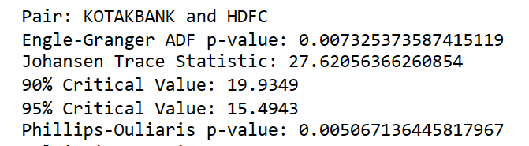
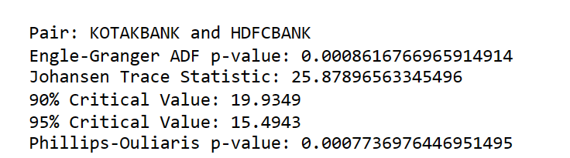
Cointegration test Results
Pairs [KOTAKBANK & HDFC] and [KOTAKBANK & HDFCBANK]
As per the test results they pass the cointegration test and we fail to reject null hypothesis.
Hence we accept that pairs are correlated

Slide 17
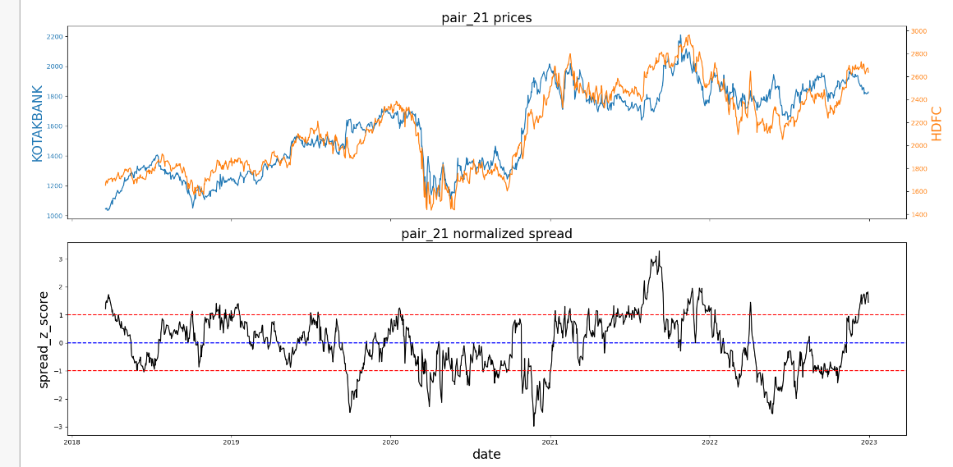
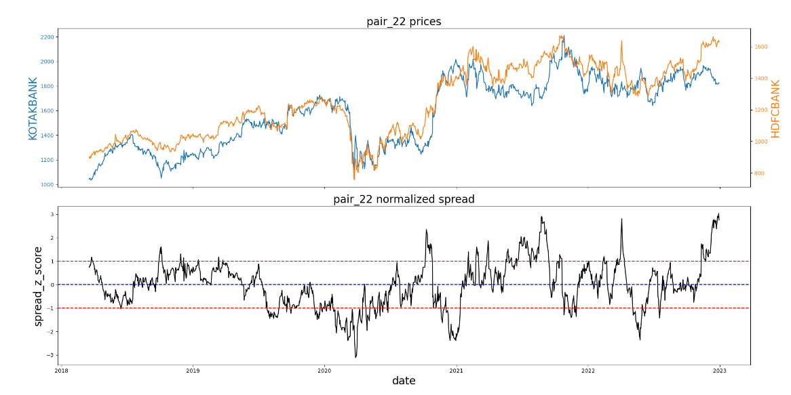
PLOTS

Slide 18
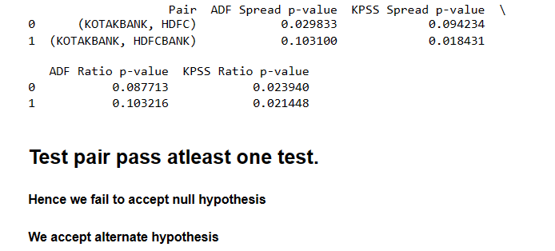
Step-8 Test data analysis
Why try to implement the tests on test data to prove the fact that test data has same behaviour as per the train data.
H0 - Test data have no relation with the train data
H1 - Test data have relation with train data

Slide 19
Step-9 Generating Signals
As we have learnt that test data is has same behaviour as train data. We will do signal analysis and returns calculation on test data for last 30 days window.
We taken it as a short term strategy, and for the next 30 days will be perfect for evaluation.

Slide 20
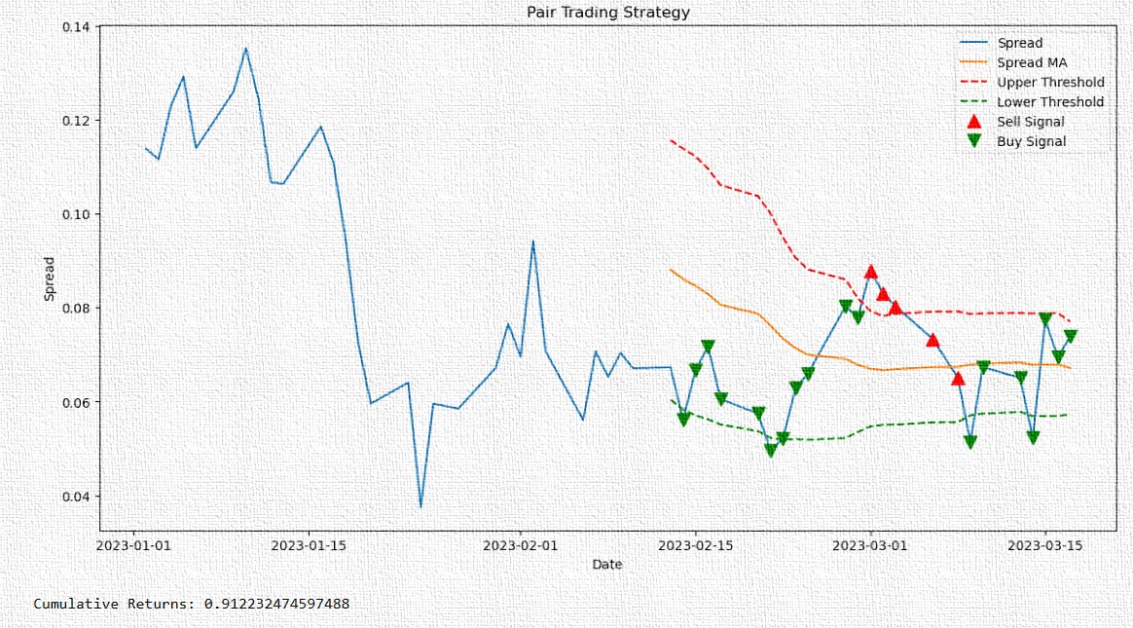
KOTAKBANK-HDFCBANK

Slide 21
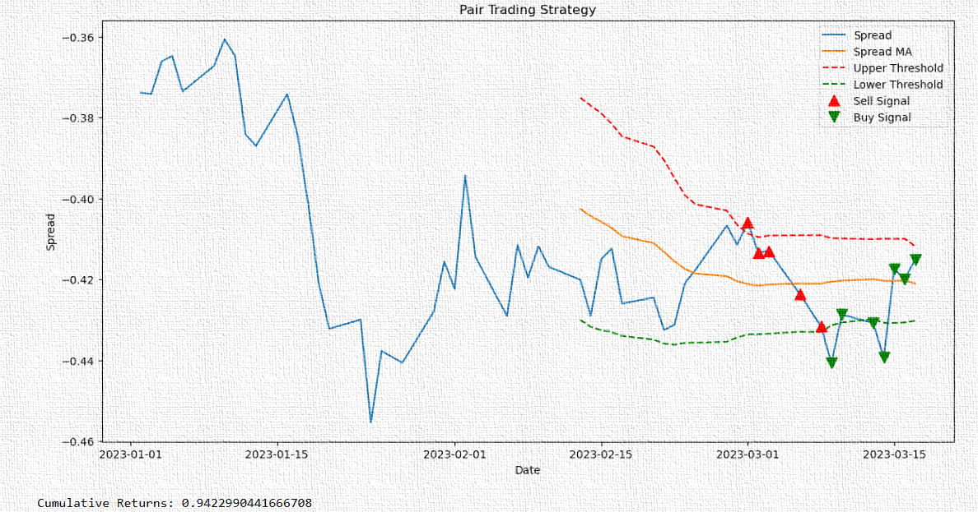
KOTAKBANK-HDFC

Slide 22
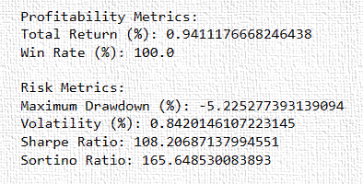
Metrics

Slide 23
Risk Management
Position Sizing: Determine the appropriate size of each trade based on the level of risk you are willing to take. This can be done by allocating a certain percentage of your total capital to each
Stop Loss Orders: Implement stop loss orders to automatically exit a trade if the losses reach a predefined threshold. This helps limit potential losses and protects capital from significant drawdowns.
Maximum Drawdown Limit: Set a maximum allowable drawdown for your trading strategy. If the drawdown exceeds this limit, temporarily halt trading or reevaluate the strategy to identify potential issues.
Portfolio Diversification: Diversify your pair trading portfolio by trading multiple pairs or incorporating other uncorrelated trading strategies. Diversification helps spread risk across different assets and reduces the impact of adverse movements in any single position.
Risk-adjusted Position Sizing: Adjust position sizes based on the volatility or risk of each pair. For example, you can allocate smaller positions to pairs with higher volatility to manage risk effectively.
Back testing and Stress Testing: Conduct thorough back testing and stress testing of your pair trading strategy to evaluate its performance under various market conditions and identify potential weaknesses. This helps uncover any hidden risks and allows for adjustments before deploying the strategy with real capital.

Slide 24
Conclusion
We can use different strategies as per our portfolio and hedging strategies. These stocks have been tested through multiple advance level of mathematical means.

Slide 25
THANK YOU

